Slide 8
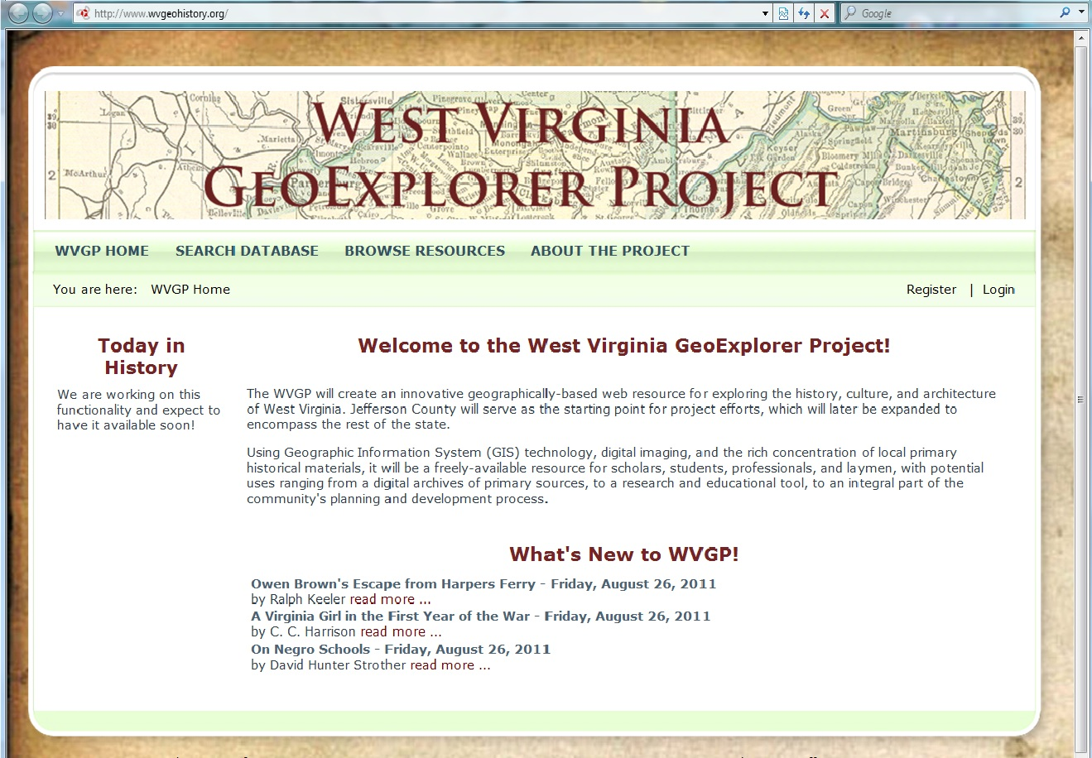

Slide 9
The West Virginia GeoExplorer Project is located at: http://www.wvgeohistory.org
You can try everything you see here, and more, on this website.

Slide 10
This button shows you info. about project goals, sponsors, and specifications.

Slide 12
This button lets you search the database of more than 25,000 items. New items are constantly being added.

Slide 13
Currently, you can search the database using five parameters, alone or in combination:
Date Range
Document Text
Author (or Property Owner)
Topics
Location

Slide 14
Use Date Range to find an event that falls between two dates.

Slide 15
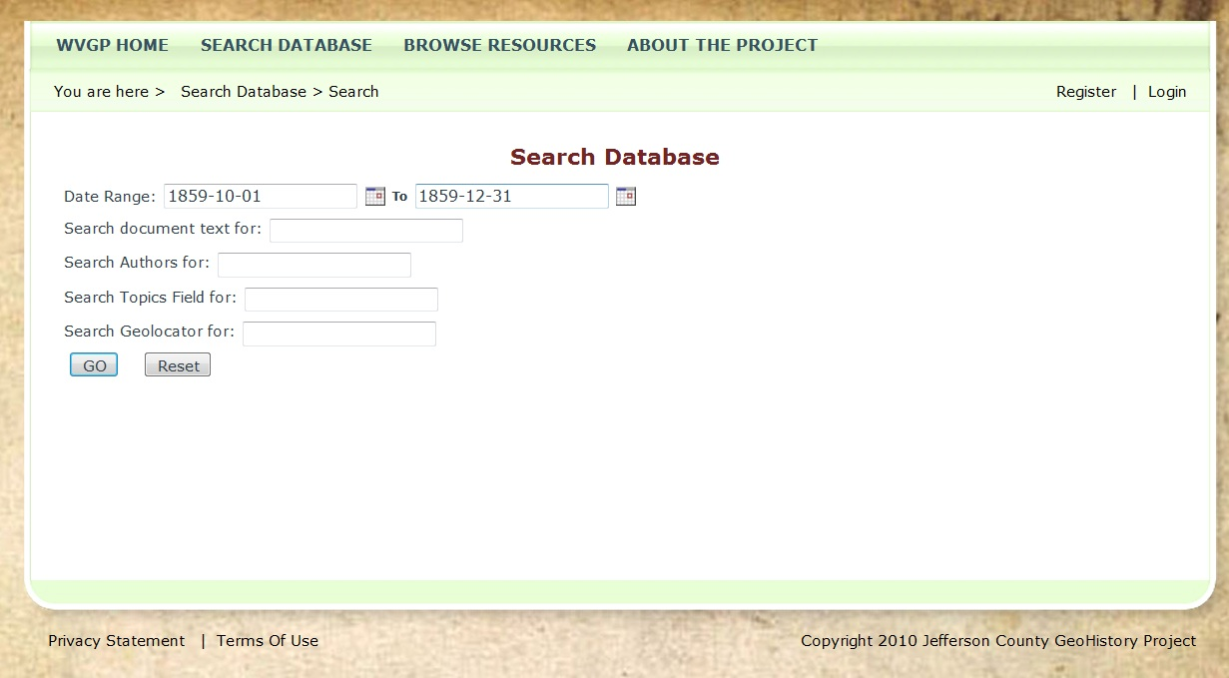
For example, between October 1, 1859 and December 31, 1859.
Click the GO button to launch the search.

Slide 16
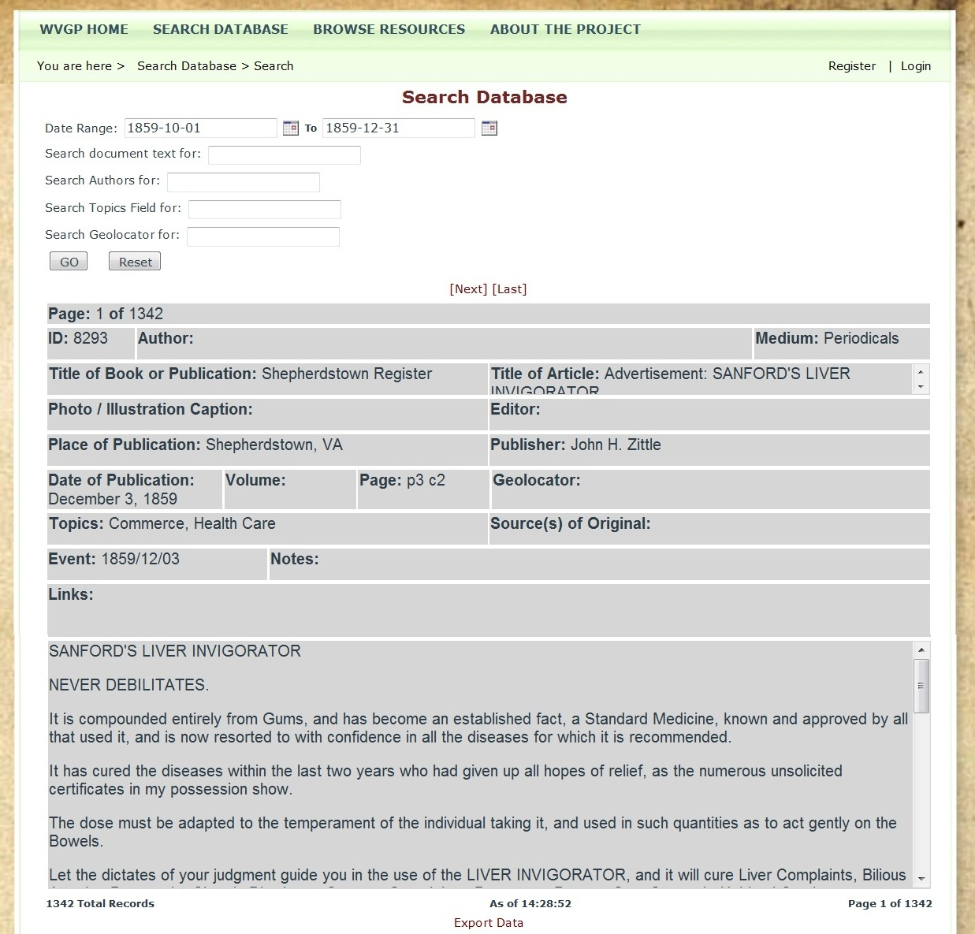
You will reach a page showing the results of your query.

Slide 17
This line shows you how many results were found.

Slide 18
The text of this item appears in this section.

Slide 19
Use the scroll bar to see the rest.

Slide 20
Use these buttons to view another result.

Slide 21
Use this feature to search within the body text of an item.

Slide 22
For example, search for "Virginius."

Slide 23
Here is the search term you entered.

Slide 24
Use this feature to search the author field. You can also search for the name of a property owner.

Slide 25
For example, "Thomas Shepherd."

Slide 26
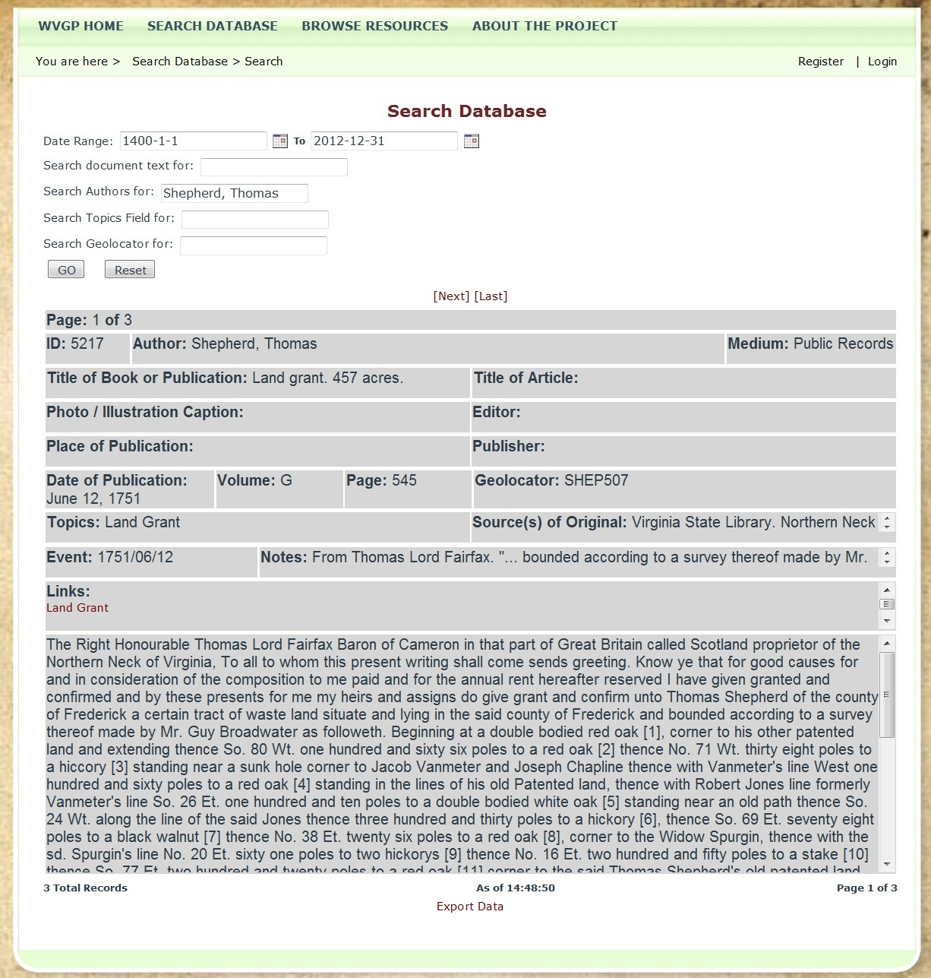
This is the text of a land grant purchased by Thomas Shepherd.

Slide 27
If a facsimile of the original document is available, click the red text to view it.

Slide 28
Here is the original.

Slide 29
Use this feature to search "see also" topics for each item.

Slide 30
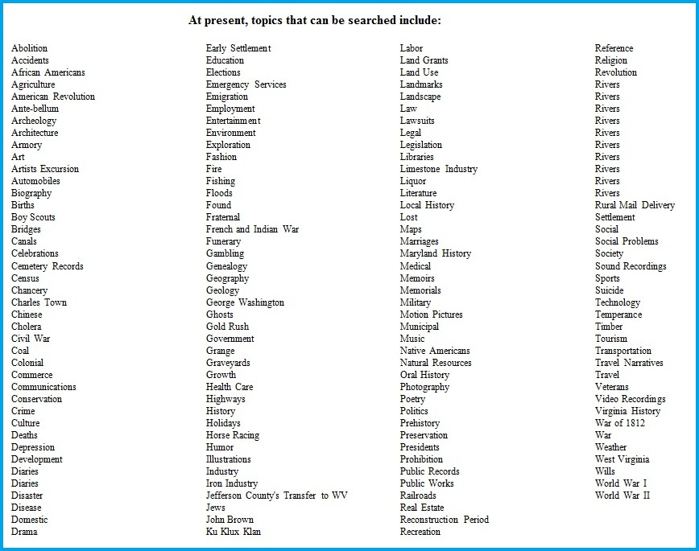
These are the topics you can search.

Slide 31
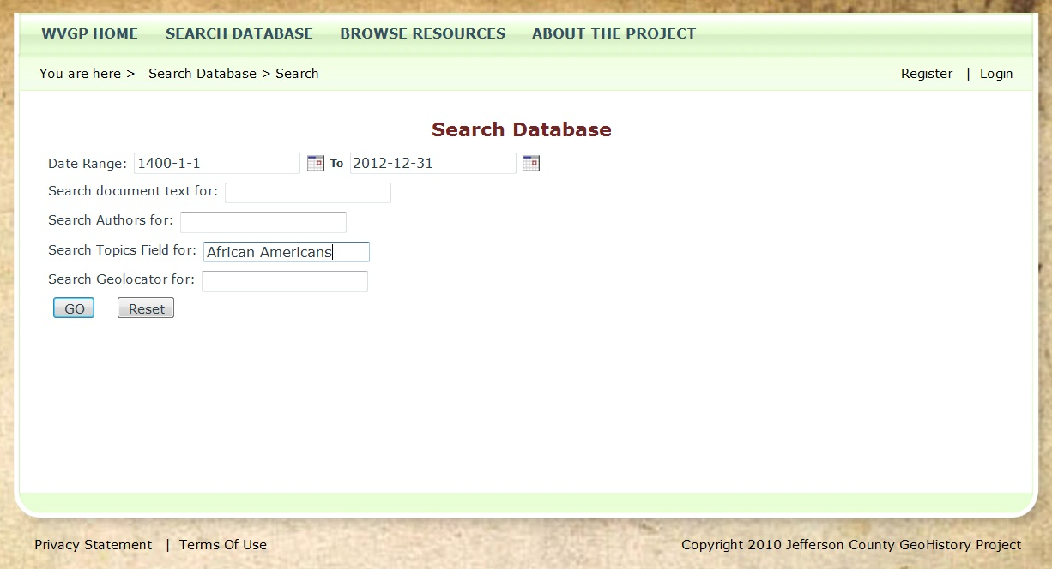
For example, search for "African Americans."

Slide 32
Here is the topic you selected.

Slide 33
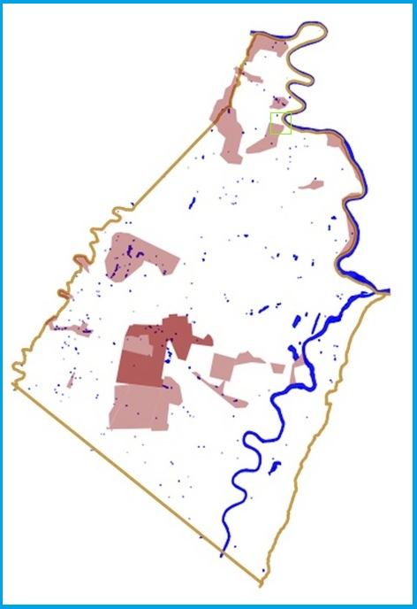
In the GIS portion of the program, all of the original land grants for Jefferson County (about 1,000) have been mapped and given a code.

Slide 34
Use the Geolocator feature to search the database by location. For example, HF60A is the code for Virginius Island.

Slide 35
Notice that the records found all have the "Virginius Island" code.

Slide 36
Here is a transcription of the document, a survey.

Slide 37
When an an item in the Links field is highlighted in red, you can click on it to see a copy of the original document.

Slide 38
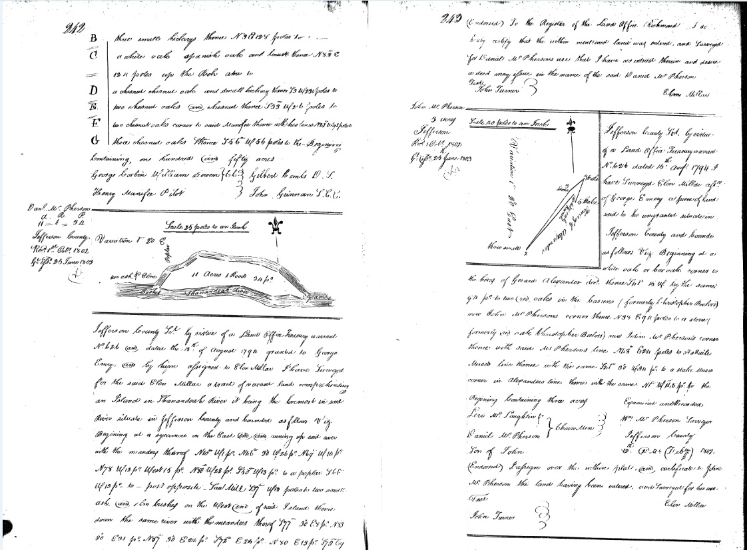
Here is a facsimile of the original document.

Slide 39
One of the records we found is a photograph of Hall's Rifle Works during the Civil War. You can view it by clicking the red link.

Slide 40
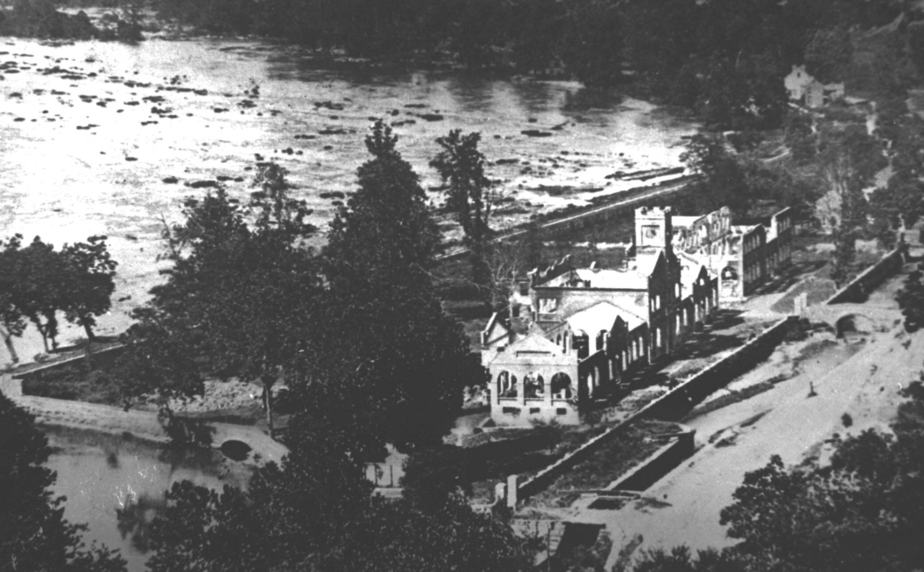

Slide 41
The Browse Resources tab contains several other ways to view information.

Slide 42
The Books feature lets you view PDF versions of original documents.

Slide 43
Click on a red link to view an item, for example, Joseph Barry's Strange Story of Harpers Ferry

Slide 44
Soon books will be viewable in both PDF and HTML format. The HTML version will be fully searchable through the Search Database feature.

Slide 45
The Photo Browser option lets you view a gallery of historic photographs.

Slide 46
Click on a thumbnail photo to view a larger version.

Slide 47
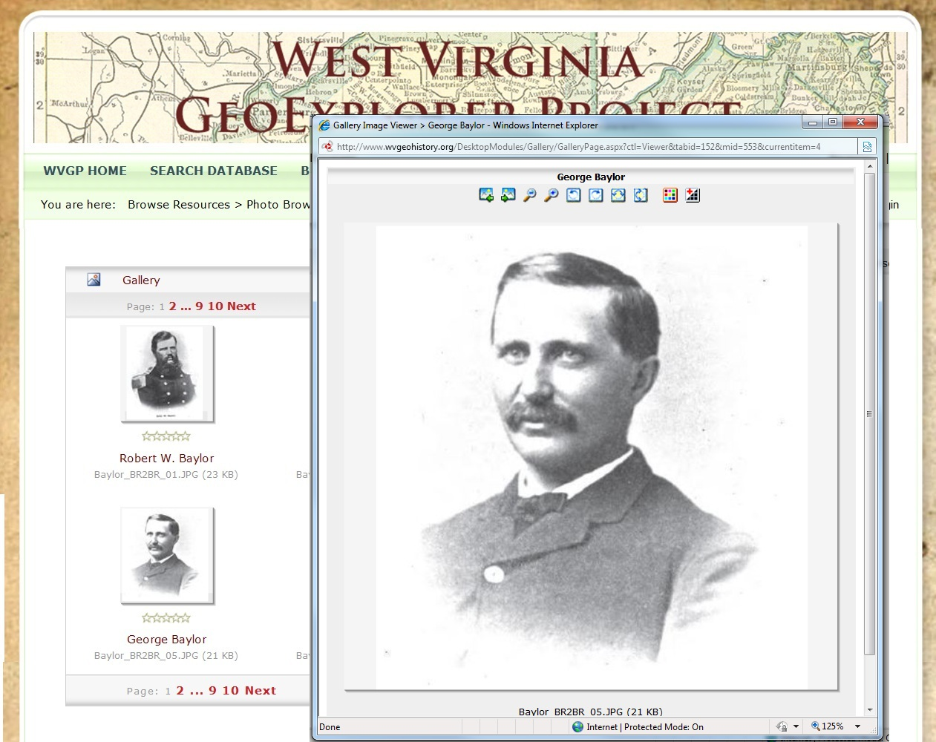
Soon the photographs will also be searchable through the more powerful Database Search option.
For Expample:
Search Medium = Photos
Topics = Civil War
... will display a list of all photographs containing the topic Civil War.
At present, we have approximately 12,000 images to be added to the database.

Slide 48
The Map Gallery option lets you view historic maps of the area.

Slide 49
Click on a red link to view a map. For example, S. Howell Brown's 1852 Map of Jefferson County.

Slide 50
You can zoom and pan to examine the map in detail.

Slide 51
The GIS Portal takes you to the mapping part of the project.

Slide 52
The GIS component is still under development, but all the major features are now in place.
The opening view shows modern Jefferson County with its roads, railroads, and water features. The system lets you zoom and pan to examine the map in more detail.
Information is stored in a series of layers: yearly polygon layers show property boundaries. Point layers are used to record features such as structures. Line layers record roads and streams.

Slide 53
Clicking features in the outline reveals or hides specific items. For example, you can hide the modern roads layer.

Slide 54
... and hide the modern railroads layer.

Slide 55
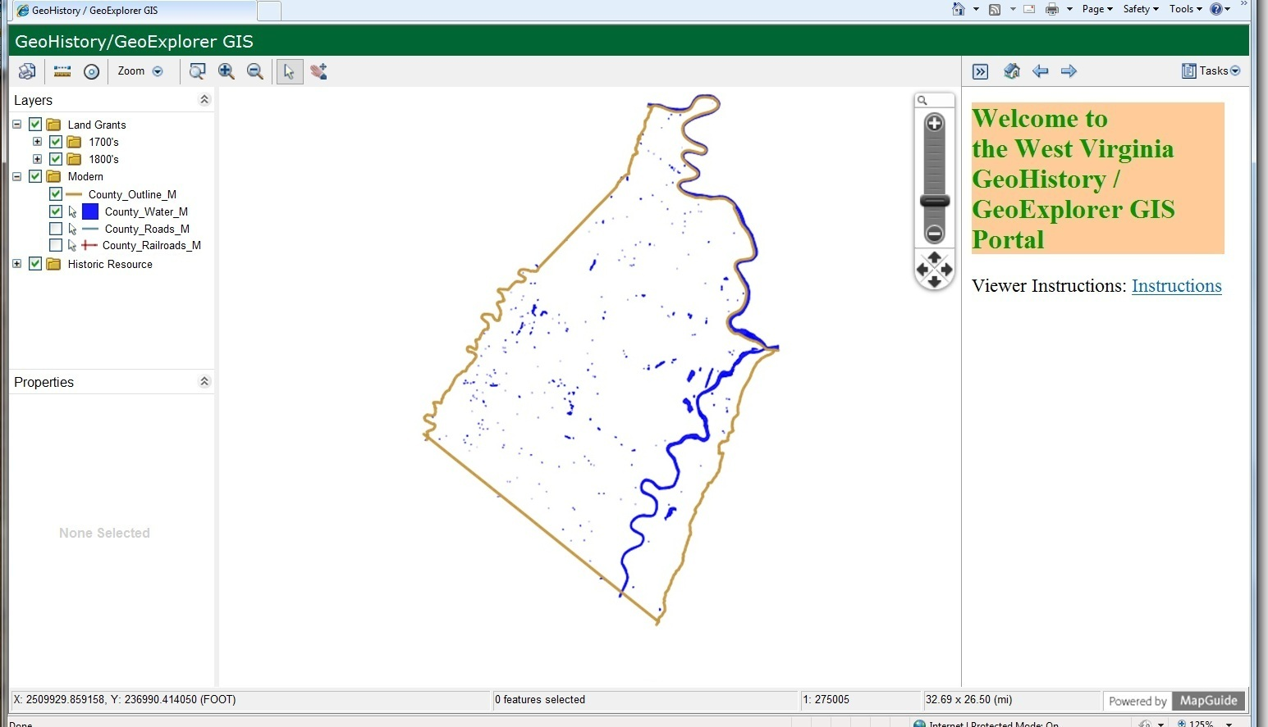
Under a grant from the West Virginia Humanities Council, we are creating a base map containing all of the earliest land grants in Jefferson County. That work is completed, and we are currently transferring that data to the GIS.

Slide 56
Clicking the + next to Historic Resources reveals layers available for viewing.

Slide 57
Checking this box reveals a portion of the Historic Buildings Survey conducted by the Jefferson County Historic Landmarks Commission.

Slide 58
Each point represents a structure. Clicking on a point reveals information about it.

Slide 59
Information about this feature appears here.

Slide 60
Clicking the + next to 1700s in the Land Grants section, expands the outline to reveal decades.

Slide 61
Clicking the + next to a decade, such as 1730-1739, reveals the annual polygon (boundary) layers in that group.

Slide 62
Checking the 1734 layer reveals the land grants for that year.

Slide 63
Clicking a land grant highlights it and displays information about the property.

Slide 64
Here is the information about this land grant.

Slide 65
Eventually you will be able to use a single search to find information in both the GIS and Search Database components.

Slide 68
Virginius Island 1803

Slide 69
Virginius Island 1824

Slide 70
As Dr. Warren Hofstra has noted...

Slide 71
The Historical Gazetteer will help us discover and interpret our complex cultural landscape.

Slide 72
This feature is under construction. You can view our progress by clicking this button on the Home page.

Slide 77
The Personal Information database includes profiles of individuals, including data on family members and PINS. These profiles help differentiate persons with the same name.

Slide 78
When PINs are added to materials such as census records or deeds, these sources can be searched with speed and precision.

Slide 79
Individual U.S. Census records for Jefferson County (West) Virginia have been incorporated into database format for the decades 1850 to 1880. These records will be searchable. Census data from 1800 to 1840 will be added as time permits.
PINS can also be assigned to these records, allowing us to link these records to other annotated resources, such as book, newspaper articles, photographs, etc.

